Slide 1


Slide 2
K-MAP
KARNAUGH MAP
Developed by MAURICE KARNAUGH OF BELL LAB in 1953.
CIT,2- Year ELT-II

Slide 3
Karnaugh map (K-map)
Karnaugh map (K-map) is used to simplify the Boolean expressions in pictorial formet without using Boolean laws or Theorems.
CIT,2- Year ELT-II

Slide 4
K-map can take two forms:
Sum of product (SOP)
Product of Sum (POS)
SOP (Sum of Products) and POS (Product of Sums) are two standard ways to represent Boolean functions. SOP forms a function as a sum of product terms, typically using minterms to represent outputs of 1, while POS forms a function as a product of sum terms, typically using maxterms to represent outputs of 0. SOP is used for active high logic (output is 1), and POS is used for active low logic (output is 0).
Characterization | SOP | POS
Definition | SOP is sum of the minterms. | POS is the product of maxterms.
Stands for | SOP stands for Sum of Product. | POS stands for Product of Sum.
Representation | It represents minterms. | It represents maxterms.
Logic | It works on active high logic. | It works on active low logic.
Denotation | It is denoted by Σ. | It is denoted by П.
Output | The output of SOP is 1. | The output of POS is 0.
CIT,2- Year ELT-II

Slide 5
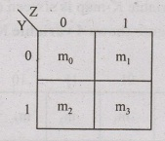
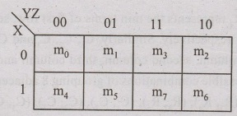
K-Map
K-Map method is most suitable for minimizing Boolean functions of 2 variables to 5 variables.
2 Variable K-Map
The number of cells in 2 variable K-map is four (22) since the number of variables is two. The following figure shows 2 variable K-Map.
3 Variable K-Map
The number of cells in 3 variable K-map is eight (23), since the number of variables is three. The following figure shows 3 variable K-Map.
• There is only one possibility of grouping 8 adjacent

Slide 6
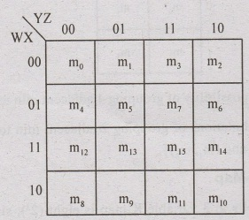
4 Variable K-Map
The number of cells in 4 variable K-map is sixteen (24), since the number of variables is four. The following figure shows 4 variable K-Map.
• There is only one possibility of g

Slide 7
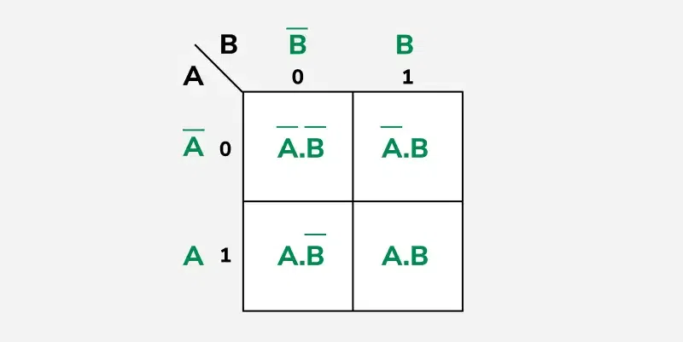
CIT,2- Year ELT-II

Slide 8
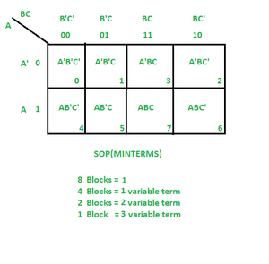
CIT,2- Year ELT-II

Slide 9
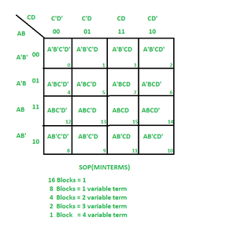
CIT,2- Year ELT-II

Slide 10
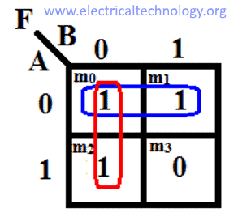
Example Question
Simplify the Boolean function
F(A,B)=∑m(0,1,2).using a 2-variable K-map.
Steps to Solution
Draw the K-Map: .
Plot the '1's:
Group Adjacent '1's:
Write the Simplified Expression:
Combine Terms:
CIT,2- Year ELT-II

Slide 11
y(A,B,C) = Σ (0,1,3,6,7)
y(A,B,C) = Σ (4,5,7)
CIT,2- Year ELT-II

Slide 12
Simplify the expression using K-maps: F(A,B,C,D)=Σ (1,3,5,6,7,11,13,14). a) AB+BC’D+A’B’C b) BCD’+A’C’D+BD’ c) A’D+BCD+A’BC+AB’C’ d) AC’D’+BC+A’BD+C’D’
Answer: c

